Slide 1
Office 365 Security and Best Practices
Paul Schnackenburg
paul@expertitsolutions.com.au
@paulschnack
TellITasITis.com.au/Conf2017

Slide 2
Agenda
Introduction
Who the attacker is and their goals
Who’s responsible for what
Attacks
Demo of Secure Score
Retention Policies
Resources
Happy to take questions throughout (and I’m available after
the presentation for any fellow introverts).

Slide 3
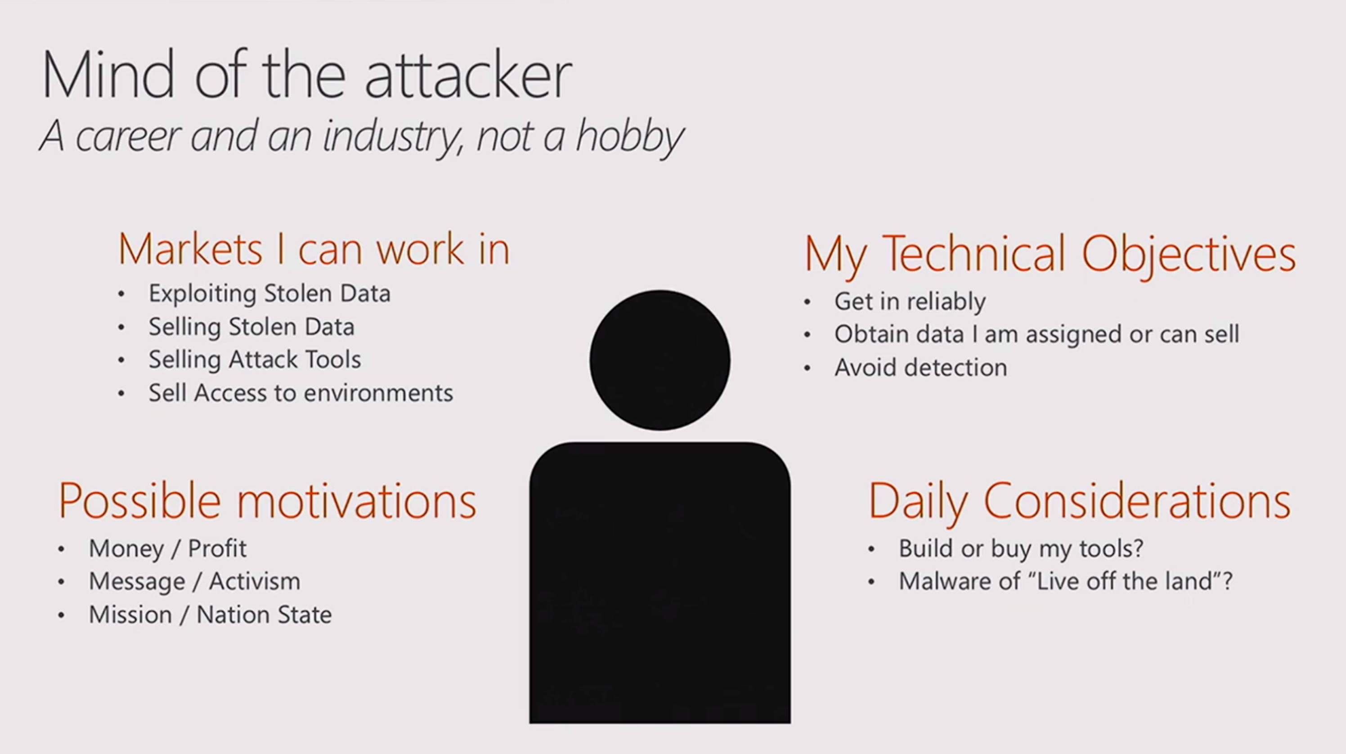

Slide 4
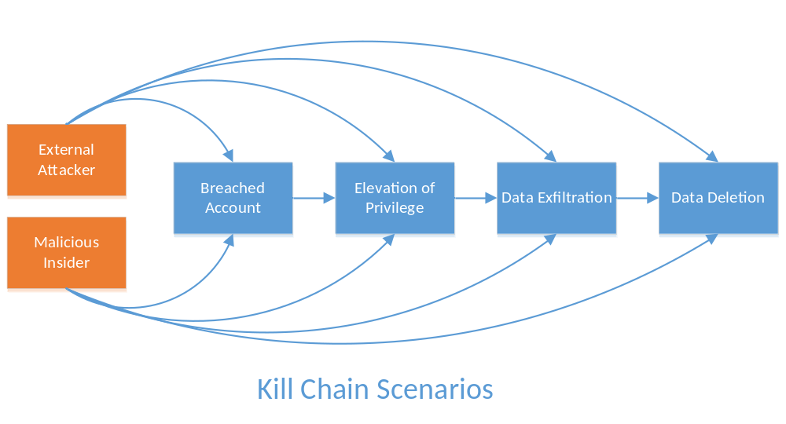
Where to start?
Kill-chain chokepoints are key attacker vulnerability.
Simple, breadth strategies most effective.
Assume breach.

Slide 5
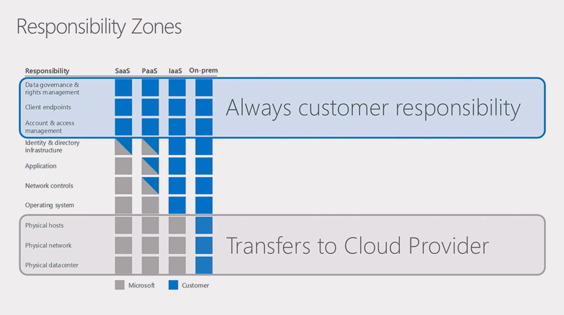

Slide 6
Customer Scenario: Spamming Exec Admin (~100 seat)
Initial Breach
  Phishing email from consumer email provider with invoice.doc embedded malware.
Method
  Very targeted initial breach (likely researched). Account creds dumped to
  Command & Control (C2).
  Exec admin account used to send invoice.doc malware to rest of company, expanding
  account breach.
  Spoofed email sent to CFO impersonating CEO asking for bank transfer (discovery point by CFO).
  Basic account cred resulted in three distinct attacks: Whaling, phishing internal, external spam.
Impact
  Nearly successful whaling attempt with potential $60K loss.
  Hundreds of hours of investigation, remediation time.
  Hundreds of lost hours of productivity.

Slide 7
Breached Account: Prevent, Detect, Remediate
Prevent
  Multifactor authentication is the best, simplest answer.
  Difficult to crack password policies, and re-use prevention.
  End user education.
  Aggressive anti-malware attachment policies.
Detect
  Audit end user activity. (!?) Strategies vary, cost dependent on scale.
  Lots of ‘features’ to drive anomaly detections: IP address, time of day, action, user agent.
Remediate
  Separation is in the preparation.

Slide 8
Customer Scenario: Airport Admin (~250 seats)
Initial Breach
  Unknown, likely cred-dumping malware on airport kiosk.
Method
  Attacker created shadow admin account, then used that to create regular user account.
  Granted delegate perms to payables clerk account, created mail forwarding rules to
  external domain.
  Gathered intelligence on accounting and downstream payments.
  Spoofed downstream customer from external (azure-hosted) domain, asked for bank
  routing update.
  Six weeks of $30K+ weekly payments, before real downstream customer asked about payment.
Impact
  $200K Loss.
  Customer trust impact.
  Hundreds of hours of investigation, remediation time.
  Hundreds of lost hours of productivity.

Slide 9
Elevation of Privilege: Prevent, Detect, Remediate
Prevent
  Multifactor authentication is the best, simplest answer.
  Difficult to crack password policies, and re-use prevention.
  Alternate accounts.
  High bar for admin access. Small admin user base, especially for standing access.
Detect
  Monitor admin activity super-ultra-mega. Make admins the priority detection.
  Lots of ‘features’ to drive anomaly detections: IP address, time of day, action, user agent.
Remediate
  Speed to remediate? “Would seem like wisdom but for the warning in my heart.”
  Investigation and scoping capability better priority. Look at EVERYTHING.
  ACL’s, mail config, new and changed accounts. All could represent entrenchment.

Slide 10
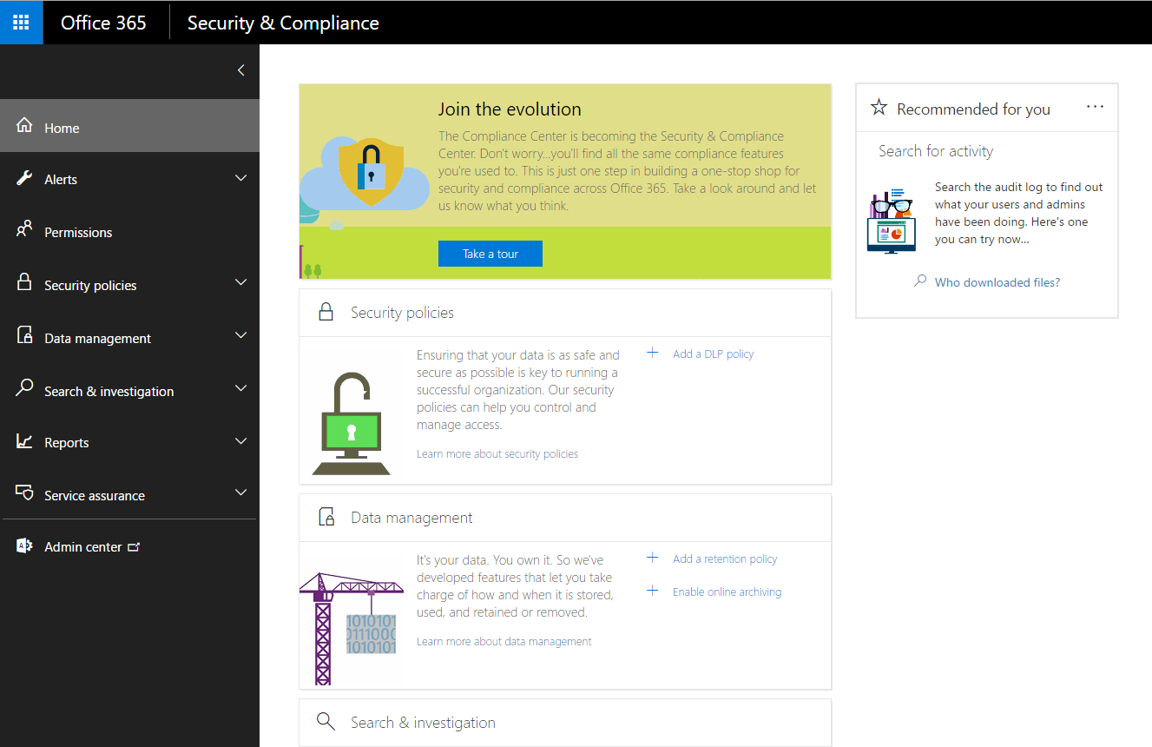
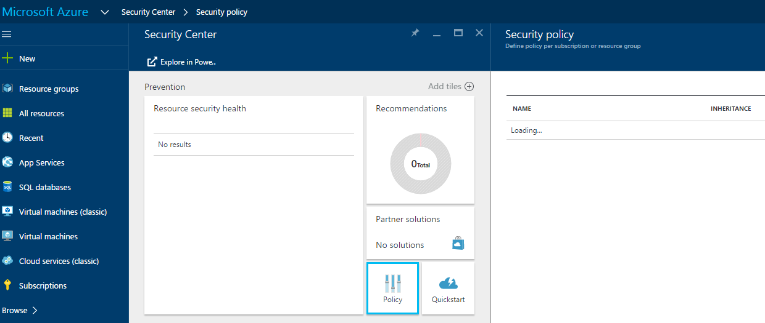
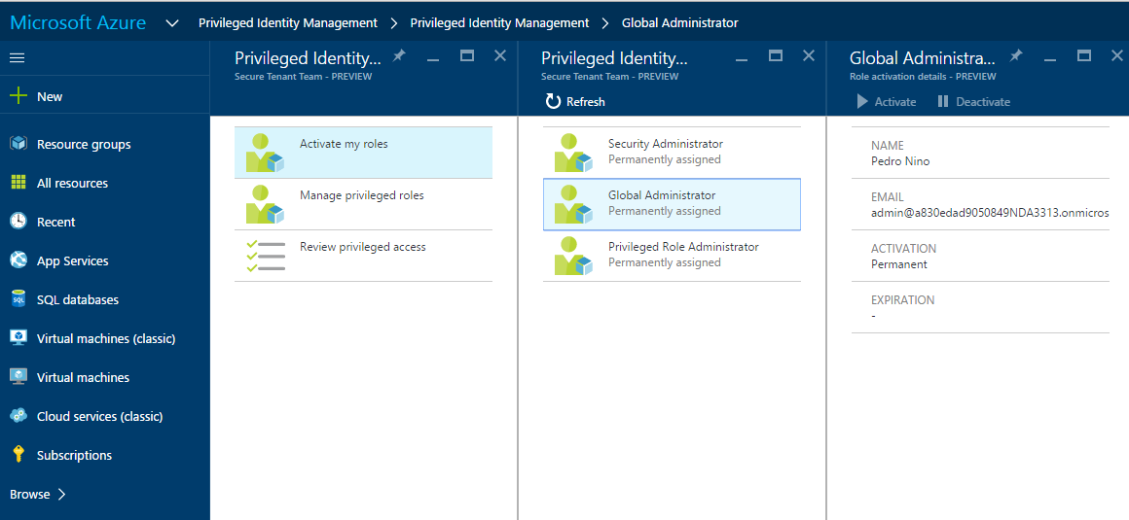
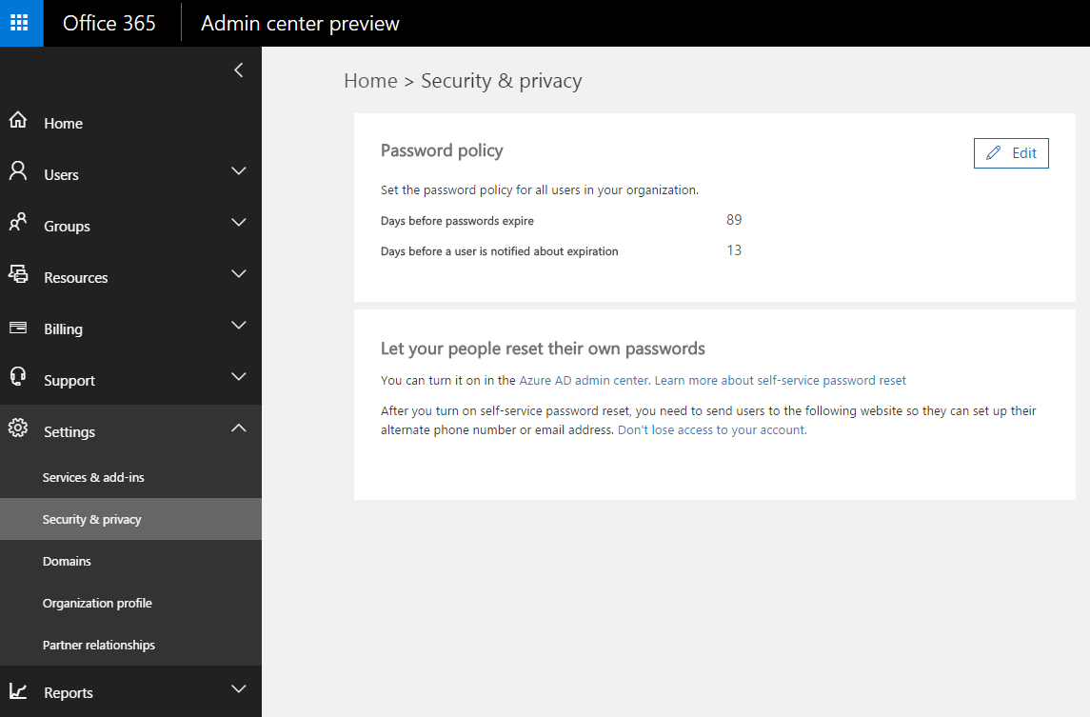
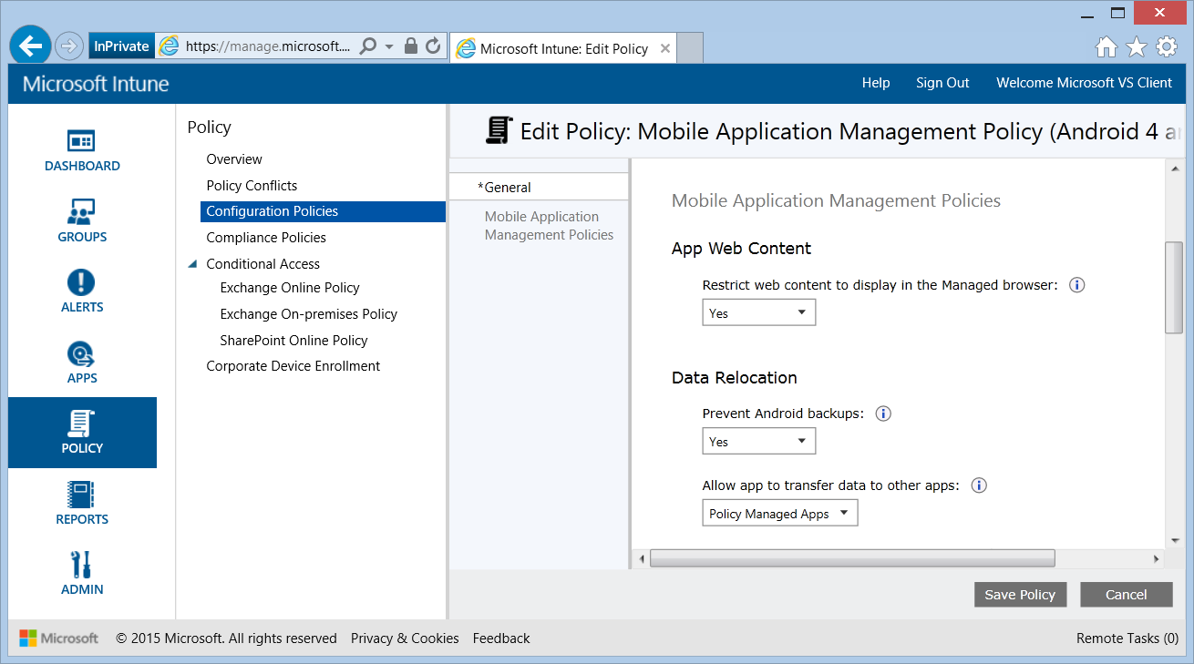
Where…how…what?
Customers don’t know where to go to explore and adopt O365 security technologies.

Slide 11
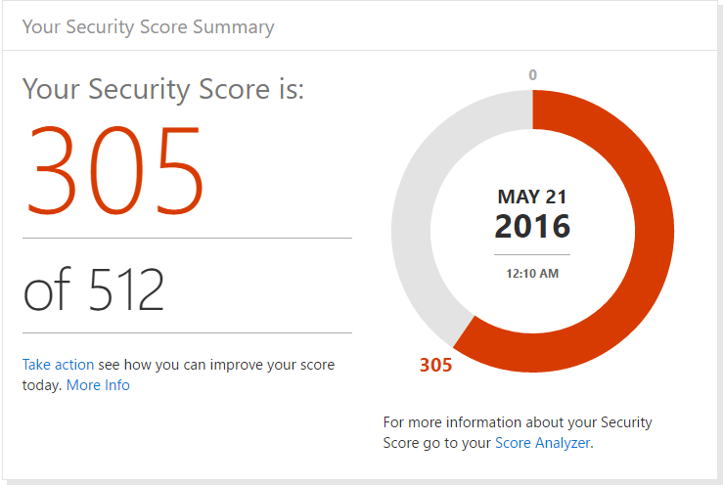
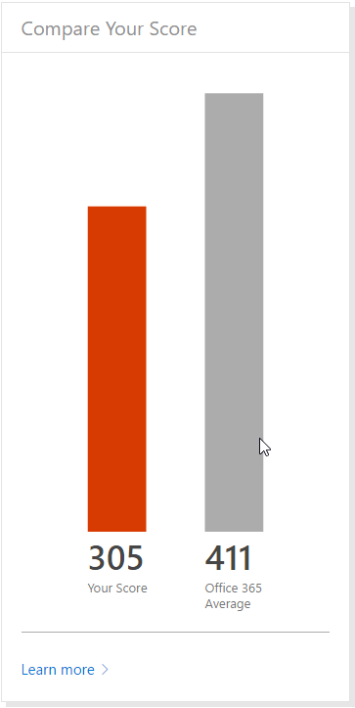
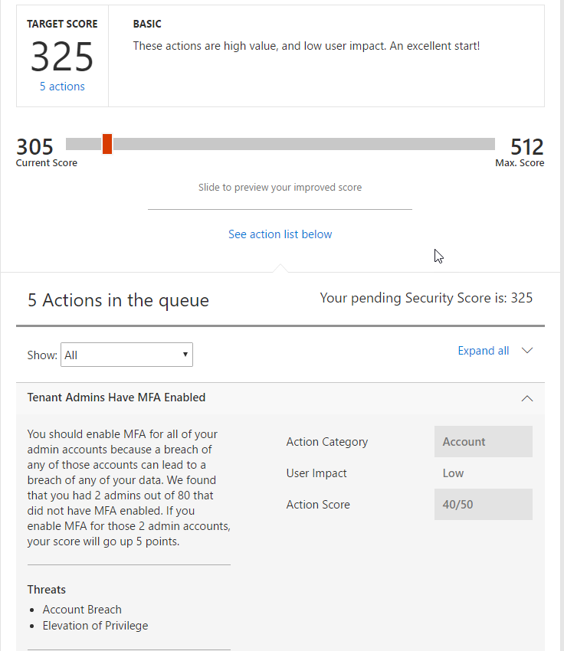
Your Secure Score
Secure Score figures out what Office 365 services they are using, then looks at their configuration and behaviors and compares it to a baseline asserted by Microsoft. If their configuration and behaviors are in line with best practices, they’ll get points, which they can track over time. More importantly, they’ll be able to quick determine what things they can do to reduce their risk.

Slide 12
Demo Secure Score

Slide 13
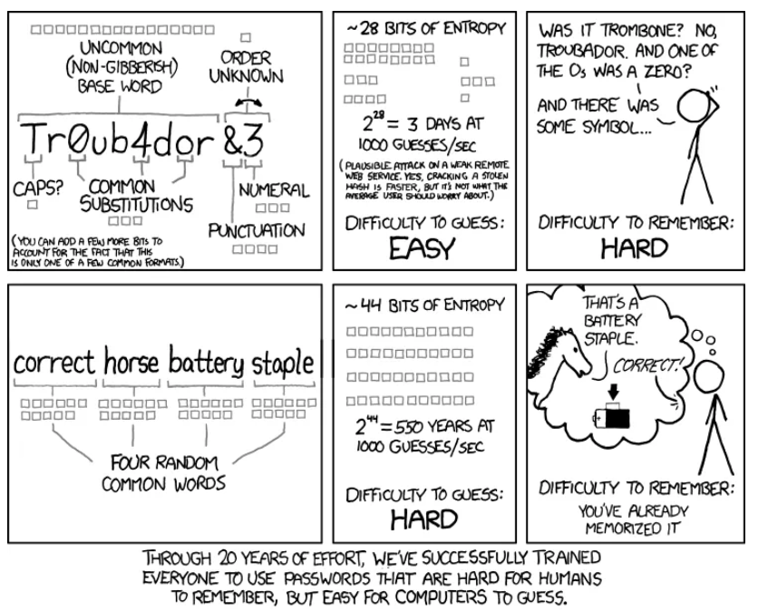
Source: https://xkcd.com/936/

Slide 14
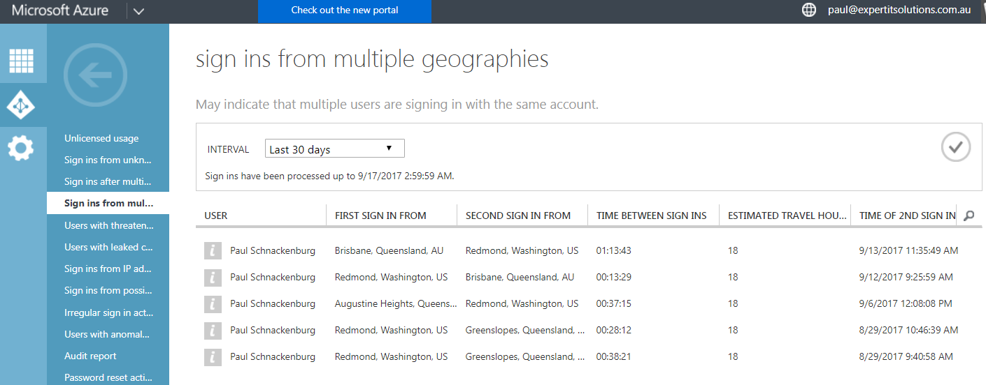

Slide 15
Question
What is the percentage of Office 365 tenants that
protects their global administrators with MFA?
0.73%

Slide 16
Retention Policies
Can have a retention policy for a tenant covering Exchange (including Public Folders), SharePoint, OneDrive, O365 Groups (files, OneNote, Team)
Can set a retention period (starts from last modified, not when policy was created)
Can also set a deletion policy such that documents and emails are deleted automatically
Can lock a policy so that it can’t be altered
Can create an advanced policy that only applies to certain documents based on keywords or sensitive information (PII)
Important to define a policy and not leave it to “chance”
Enable mailbox auditing for user actions – NOT on by default
Coming soon – Usage Score

Slide 17
Resources
All resources, including narrated videos at http://TellITasITis.com.au/conf2017
https://4sysops.com/archives/office-365-secure-score-multi-factor-authentication-mfa/ four part series on Secure Score
aka.ms/o365securitycapabilities
aka.ms/SecureCustomerMVA
https://support.office.com/en-us/article/Protect-your-Office-365-global-administrator-accounts-6b4ded77-ac8d-42ed-8606-c014fd947560?ui=en-US&rs=en-US&ad=US
https://blogs.msdn.microsoft.com/microsoft_press/2013/04/29/from-the-mvps-data-loss-prevention-with-office-365-and-exchange-online/
https://www.microsoft.com/en-us/security/intelligence-report
https://blogs.technet.microsoft.com/office365security/https://www.petri.com/flaw-in-exchange-online-auditing
https://support.office.com/en-us/article/Overview-of-retention-policies-5e377752-700d-4870-9b6d-12bfc12d2423

